Slide 1
Predicting Flood Events: A Machine Learning Approach Using GeoTIFFData
Uparna Das, Shreya Bisht,
Tapolagno Bhattacharya, Ashika Bhat, Arpitha SE

Slide 2
Tittle of the Project

Slide 3
Predicting Flood Events:
A Machine Learning Approach Using GeoTIFFData

Slide 4
Problem Statement

Slide 5
As climate change accelerates, the frequency and intensity of extreme hydrometeorological events, such as floods, have significantly increased. Accurate flood prediction is critical for minimizing damage, safeguarding lives, and optimizing emergency response efforts. However, traditional flood prediction methods often lack precision and timeliness, necessitating the development of advanced predictive systems.

Slide 6
Business Understanding

Slide 7
Floods are one of the most frequent and devastating natural disasters.
Accurate flood prediction can help reduce economic loss and save lives.
Traditional flood prediction methods are limited in real-time accuracy.
Goal: Develop a robust flood prediction system using machine learning and optical satellite imagery.
End users: Disaster management agencies for real-time flood response.

Slide 8
Approach

Slide 9
Employed Random Forest and Convolutional Neural Network (CNN) models.
Leveraged optical imagery with multiple spectral bands for pixel-wise flood classification.
Preprocessed the optical data to normalize pixel values and ensure accurate predictions.
Models were trained to predict flood-prone areas based on spectral information.

Slide 10
Data Understanding

Slide 11
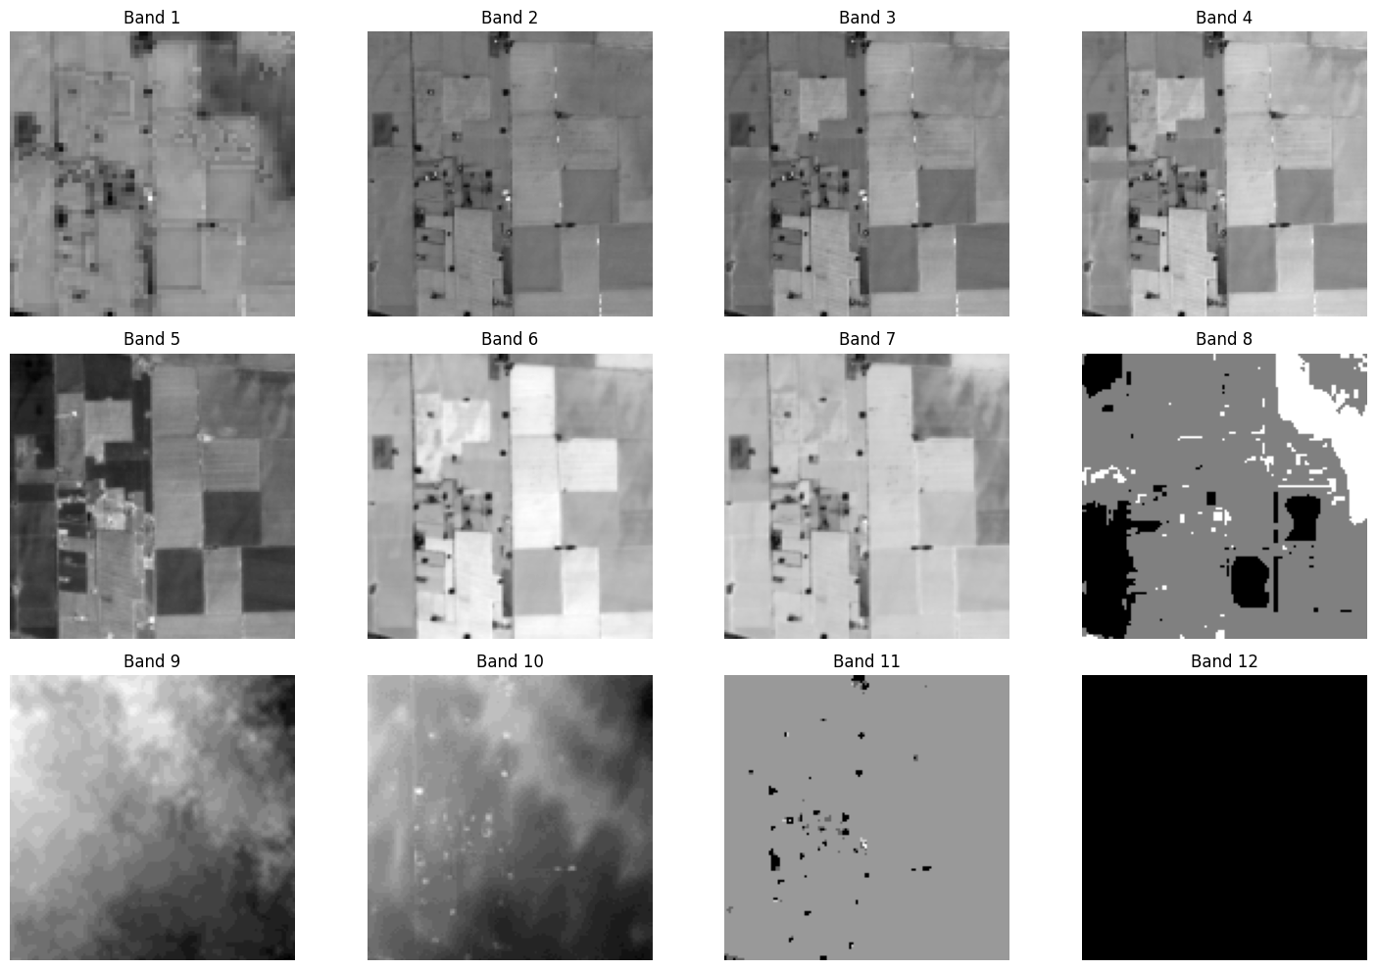
Dataset from the IEEE GRSS Data Fusion Contest (Track 2).
306 images, each with 12 spectral bands (optical imagery).
Each image is labeled with ground truth flood maps (flooded vs. non-flooded regions).
The dataset includes diverse geographical terrains, providing a wide range of flood scenarios.

Slide 12
Summary of the Dataset

Slide 13
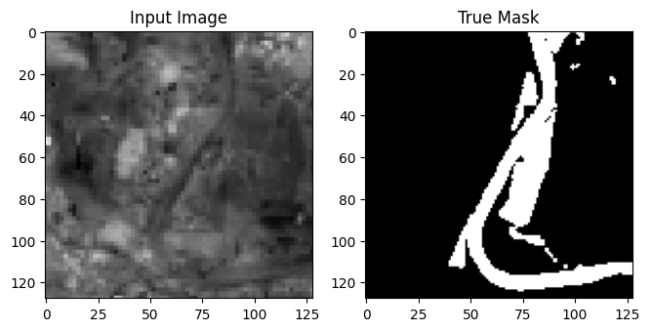
Total images: 306.
12 spectral bands per image (optical imagery covering different light wavelengths).
Ground truth flood maps provided for training.
Data covers diverse geographical areas, with varying flood-prone characteristics.

Slide 14
Exploratory Data Analysis

Slide 15
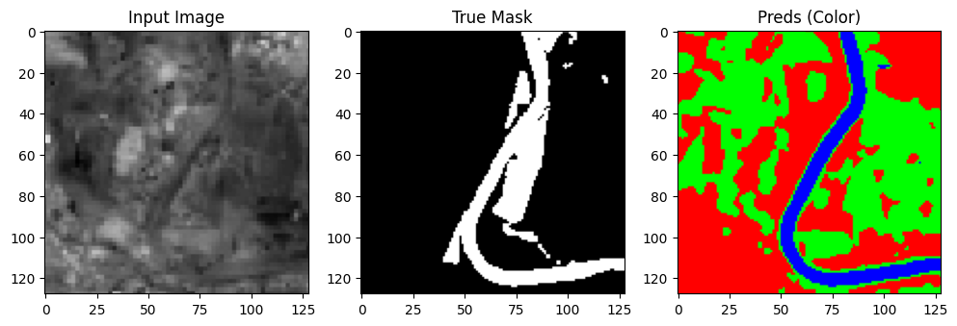
Inspected optical bands for water vs. non-water features.
Examined the distribution of flooded vs. non-flooded regions.
Analyzed spatial variability across different geographical regions.
Observed patterns in pixel intensity, with clear distinctions between water bodies and land.
Topographical features (elevation) played a key role in determining flood risk.

Slide 16
Data Visualisation

Slide 17
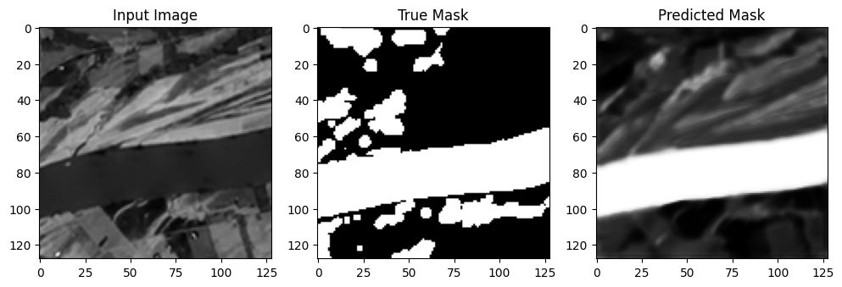
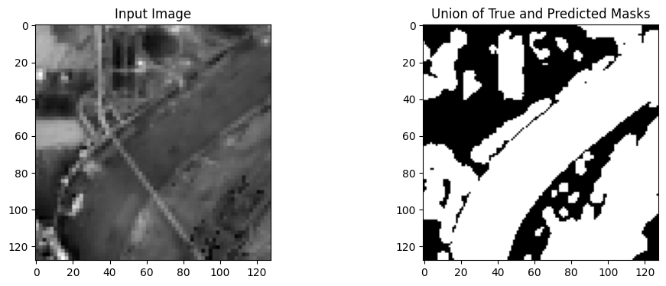
Band Visualization: Visualized the 12 optical bands to analyze patterns.
Flood Masks: Compared true flood masks with model-predicted masks.
Union of True and Predicted Masks: Visualized the overlap between predictions and actual flood areas.

Slide 18
Data Preparation

Slide 19
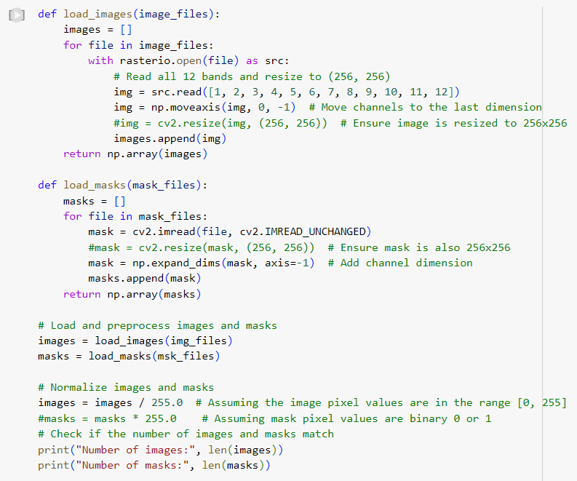
Band Normalization: Scaled pixel values across all optical bands for consistency.
Feature Engineering: Extracted pixel-wise values from each band to serve as input features for the models.
Binary Mask Creation: Generated binary masks for flooded vs. non-flooded areas to support supervised learning.

Slide 20
Data Modelling

Slide 21

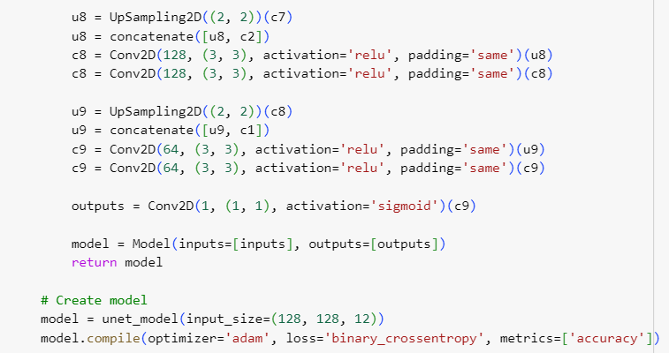
Random Forest:
Effective at handling multi-band optical data and identifying key features.
Provided interpretability through feature importance.
CNN:
Convolutional layers captured spatial patterns in the optical data.
High performance in detecting flooded regions based on pixel-level classification.
Cross-Validation: Metrics such as precision, recall, F1-score, and IoU were used to evaluate both models.

Slide 22
Model Deployment

Slide 23
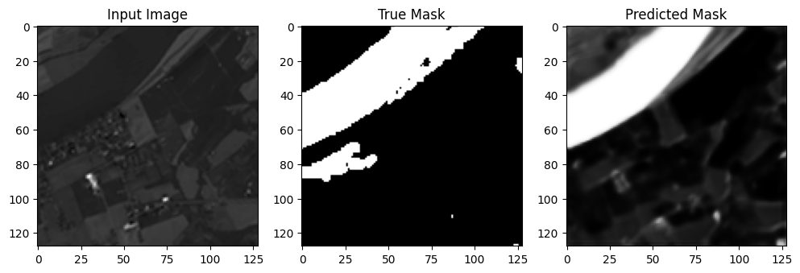
Models can be deployed for real-time flood prediction using optical data.
Future Work: Incorporating larger datasets and integrating real-time satellite data for live flood predictions.
Integration with existing GIS platforms for disaster management applications.

